Slide 1
Credit Card Fraud Detection
Machine Learning Capstone Project 2
Mozammel Hoque Sagor
Notes:
Hello. My capstone project is about detecting credit card fraud. I will cover the problem, the data, the models I built, and what the results mean for a bank. About five minutes.

Slide 2
1. The Problem
Fraud is rare: 492 of 284,807 transactions (0.17%)
A model that never flags anything is 99.83% accurate, but catches no fraud
So accuracy is the wrong measure here
Goal: catch fraud without blocking honest customers’ cards
Notes:
The problem. Out of 284,807 transactions, only 492 are fraud, about 0.17 percent. That means a lazy model that says “no fraud” every time is 99.83 percent accurate, yet useless. So accuracy is the wrong yardstick. What a bank needs is to catch fraud while not blocking honest customers, so I judged the models on how much fraud they catch and how many false alarms they raise.

Slide 3
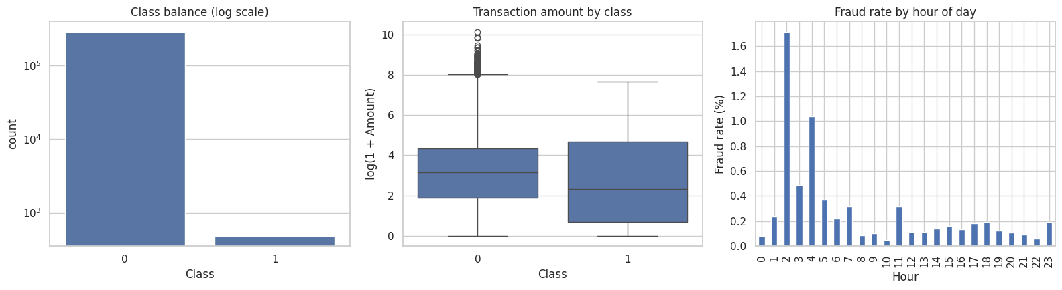
2. The Data
Kaggle Credit Card Fraud dataset: 284,807 transactions over two days
31 columns: time, amount, fraud label and 28 anonymised features
No missing values; 1,081 duplicate rows removed
80/20 train/test split; the test set has 95 frauds
Notes:
The data. 284,807 transactions covering about two days, with 31 columns: the amount, the time, the fraud label, and 28 anonymised features. No missing values. I removed 1,081 duplicate rows, then split the data 80 percent for training and 20 percent for testing, keeping the same fraud share in both. The test set contains 95 frauds. On the charts: fraud is a tiny sliver of the data, fraud amounts tend to be smaller, and the fraud rate looks higher around hours 2 and 4, though with so few night transactions that pattern is noisy.

Slide 4
3. The Solution
Baseline: Logistic Regression, one simple scoring rule (tried with class weights and with SMOTE)
Final model: XGBoost, 500 small decision trees, each one correcting the mistakes of the one before
Tuned by trying 10 settings with 3-fold cross-validation
Alarm threshold (0.84) chosen from training data only
Test set kept for the final evaluation
Notes:
The solution. I built a simple baseline, Logistic Regression, which is like one scoring checklist. Then I built XGBoost, which is like a committee of 500 small decision trees where each tree fixes the previous one’s mistakes. To keep the comparison fair, the test data stayed locked away until the end, I compared ten settings with cross-validation on the training data, and the alarm threshold was chosen from training data only. I also tried a technique called SMOTE on the baseline, which creates extra synthetic fraud examples.

Slide 5
4. Business Impact
Model | Frauds caught (of 95) | False alarms
Logistic Regression (class weights) | 83 | 1,414
Logistic Regression (SMOTE) | 83 | 1,482
XGBoost (final) | 72 | 1
XGBoost: precision 0.986, recall 0.758, F1 0.857
It misses 23 of the 95 frauds (24%)
Logistic Regression raises about 17 false alarms for every fraud it catches
Money saved is not estimated: that needs real fraud losses
Notes:
Business impact. The baseline catches 83 of the 95 test frauds, but it also flags 1,414 honest transactions, about 17 false alarms for every fraud caught. No bank team could review that. XGBoost catches 72 frauds and raises exactly one false alarm. It does miss 23 of the 95 frauds, about a quarter, and that is the main trade-off. I have not put a dollar figure on the savings because that needs real fraud losses and the cost of reviewing an alert. All numbers are on the held-out test set of 56,746 transactions.

Slide 6
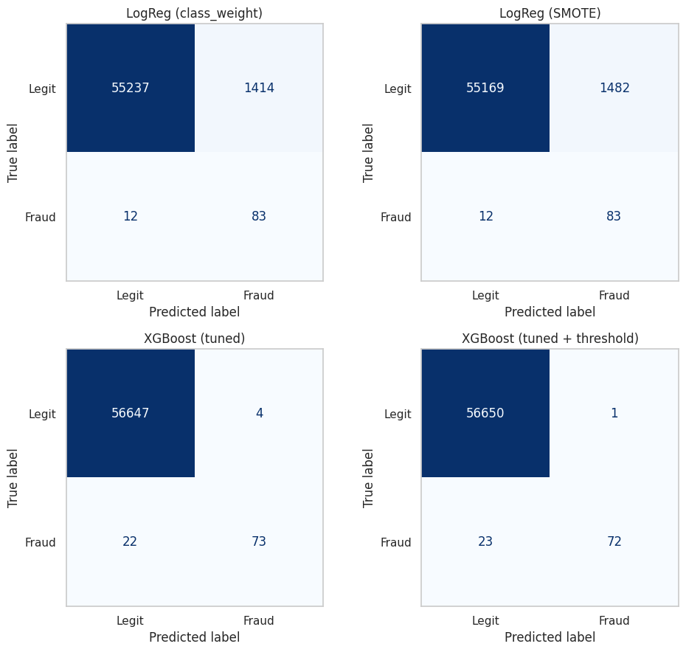
5. Demo and Next Steps
Demo
Open the notebook and run all cells
Go to section 7, “Business impact”
Read frauds caught, missed and false alarms
Next steps
Set the threshold from real fraud losses
Test on future data, not a random split
Serve the model with FastAPI
Notes:
Optional live demo. In the notebook, the last results cell prints how many frauds were caught, how many were missed, and how many false alarms there were. I can run it live, or show the confusion matrices on the right. Next steps: choose the alarm level from real fraud losses, test on future data rather than a random split, and serve the model through a FastAPI endpoint so a payment system could score transactions live. Thank you. Questions?

